Slide 1
Managing CKAN Organizations

Slide 2
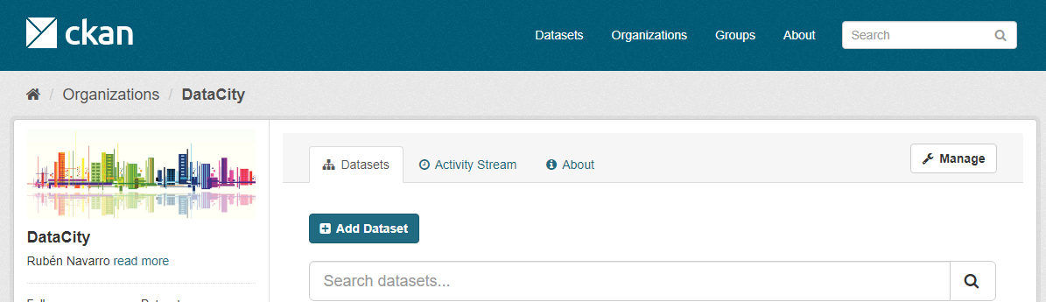
My DataCity Organization

Slide 3
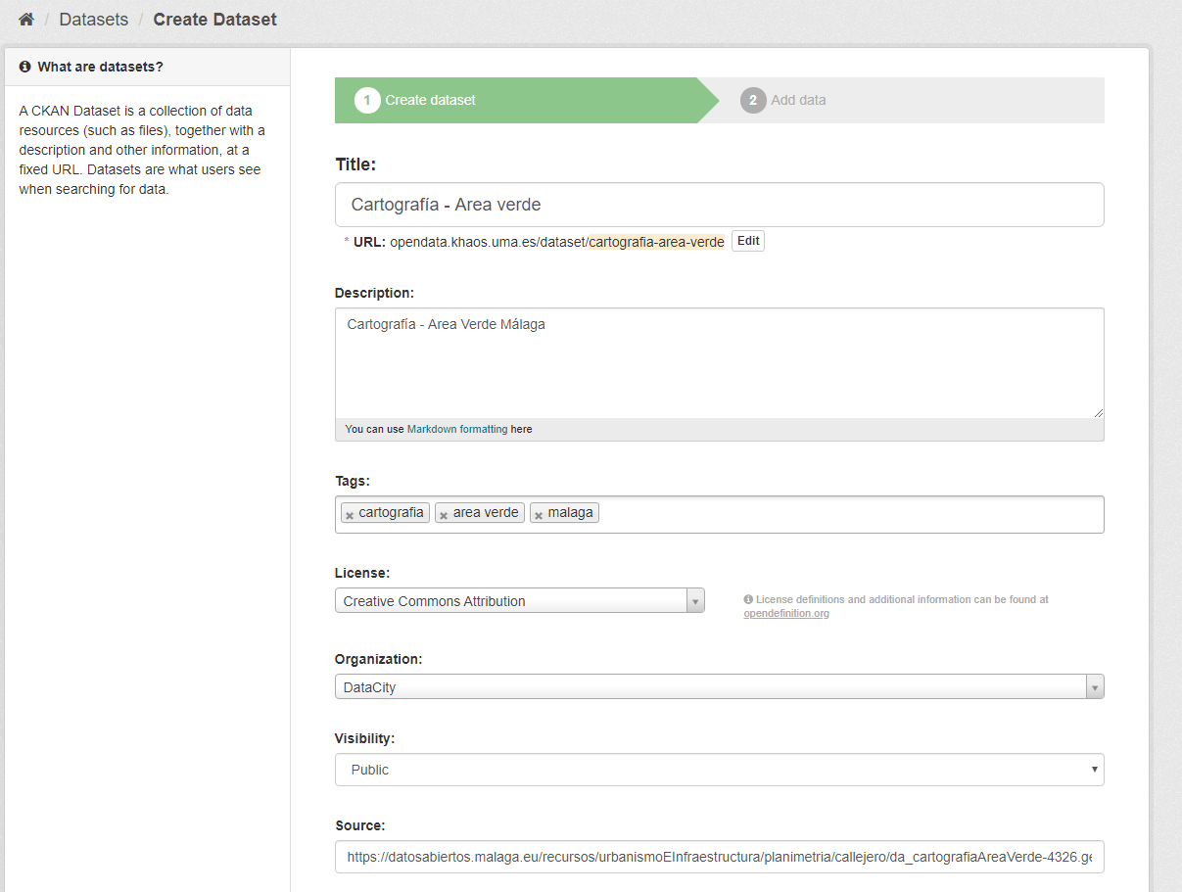
Step1. Select DataSets and Resources

Slide 4
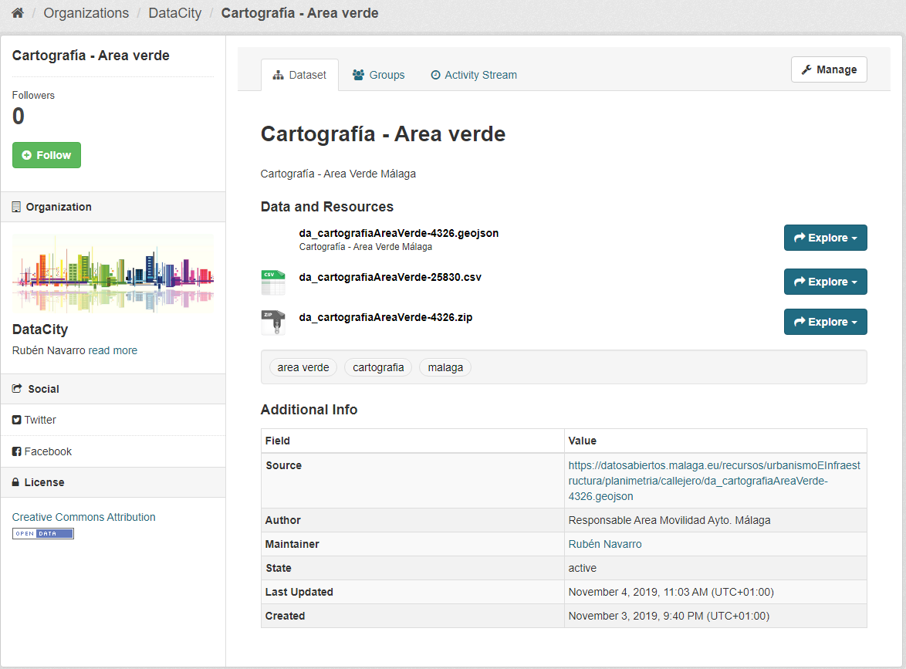
Resource 1. Cartografía – Área verde (3 different resources)

Slide 5
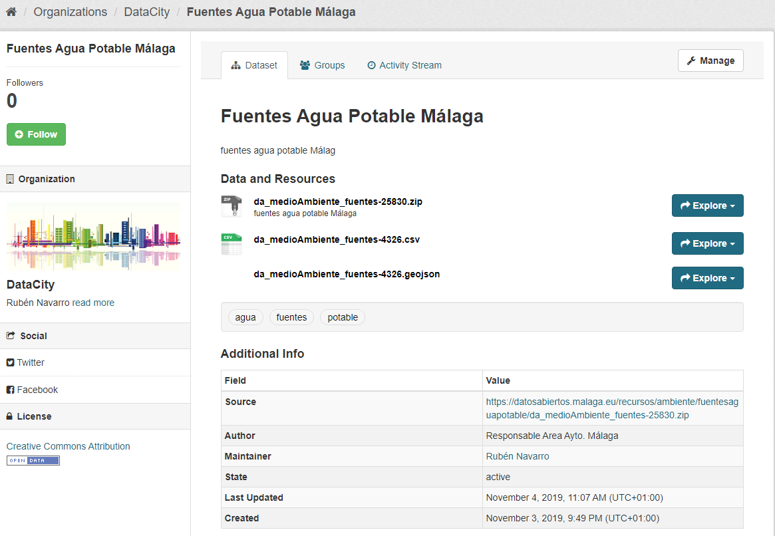
Resource 2. Fuentes Agua Potable (3 different resources)

Slide 6
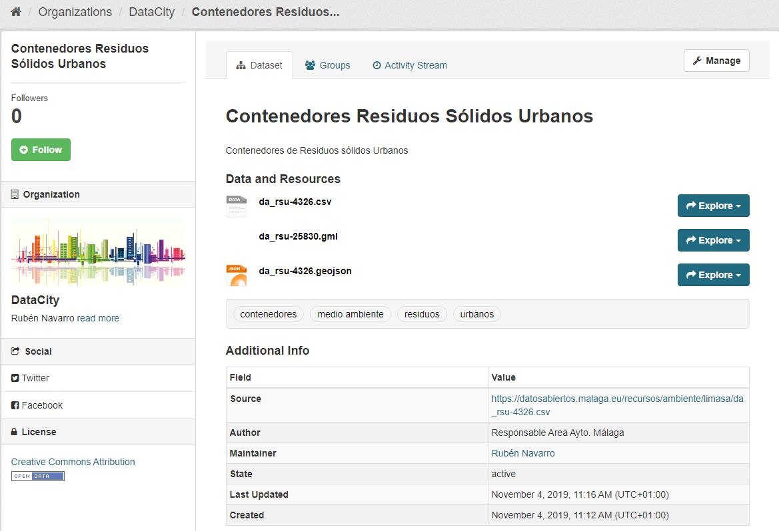
Resource 3. Contenedores Residuos Urbanos
(3 different resources)

Slide 7
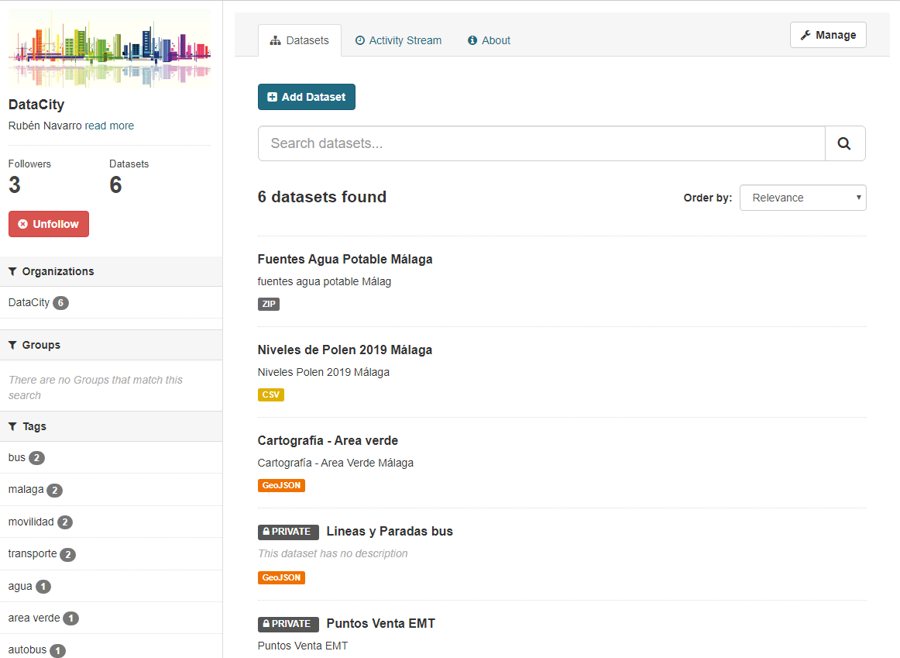
Step 2. Giving rights to colleagues

Slide 8
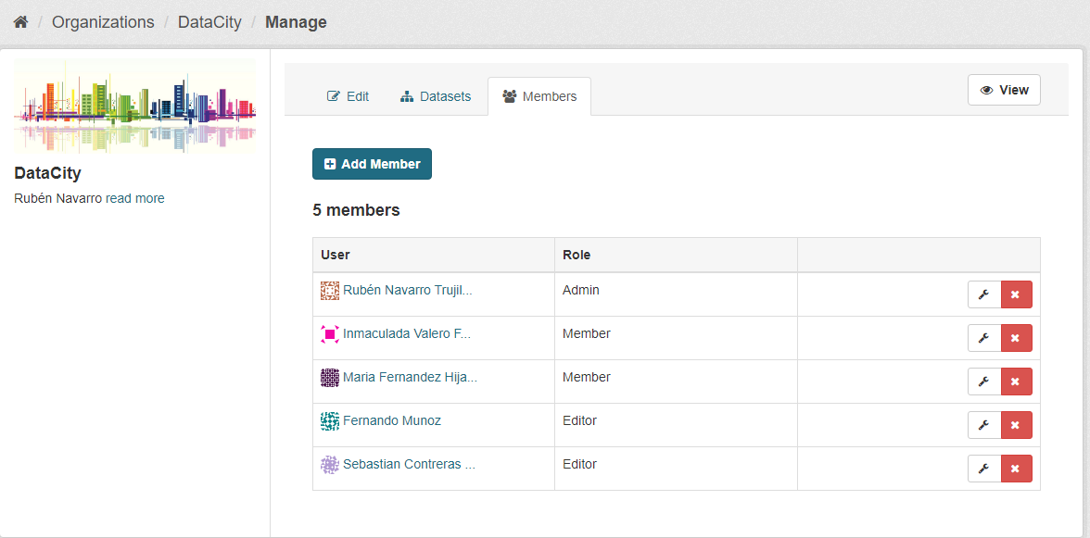

Slide 9
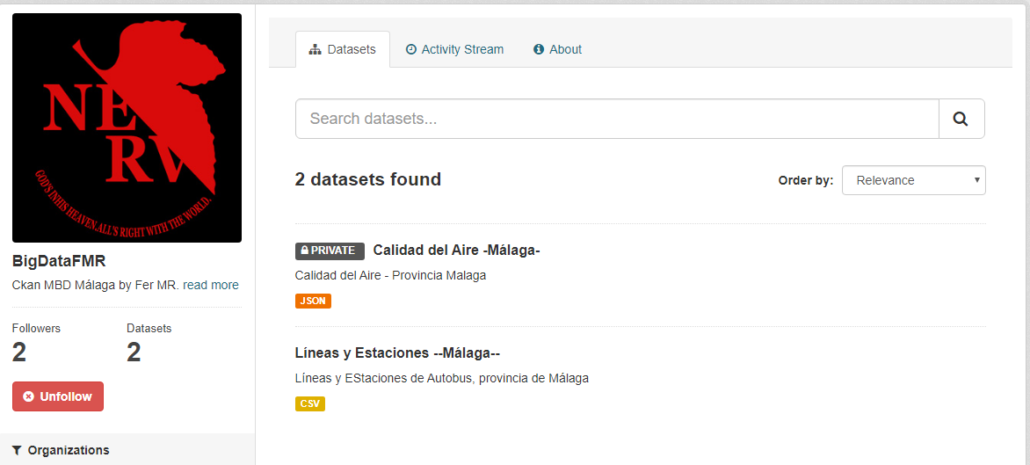
Step 3. Asking for rights from colleagues

Slide 10
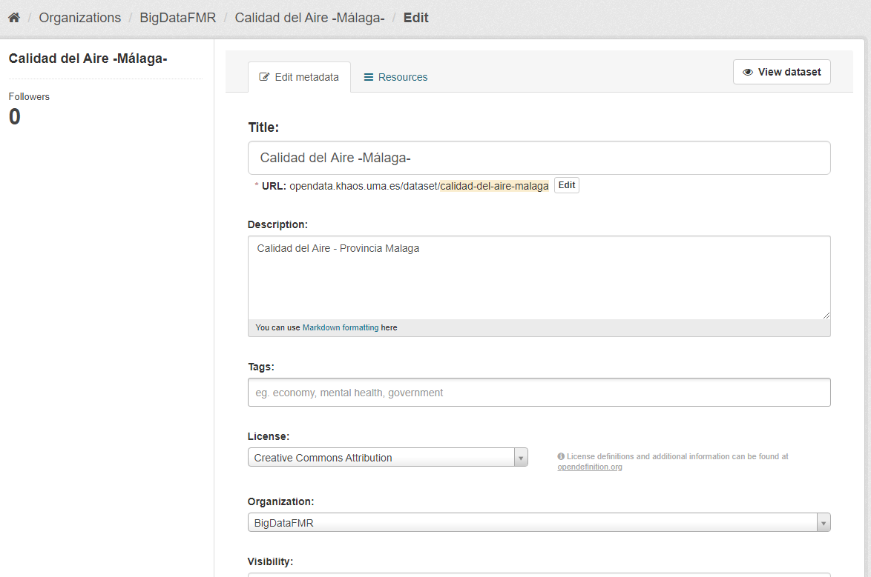
Step 4. Modifying a new Resource in other Organizations
External Resource 1 – Into BigDataFMR (owner Fernando Muñoz)

Slide 11
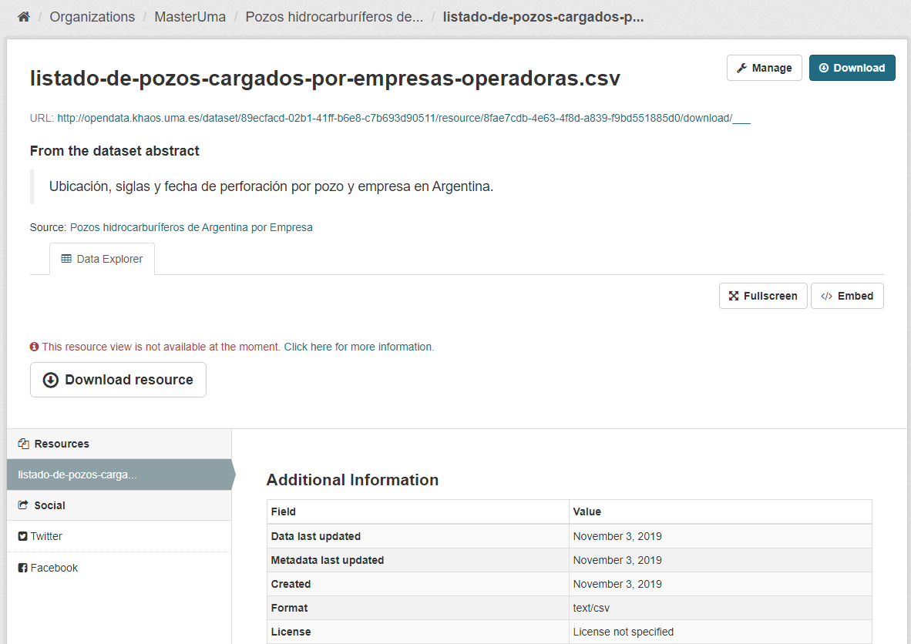
External Resource 2 – MasterUma (owner Sebastian)

Slide 12
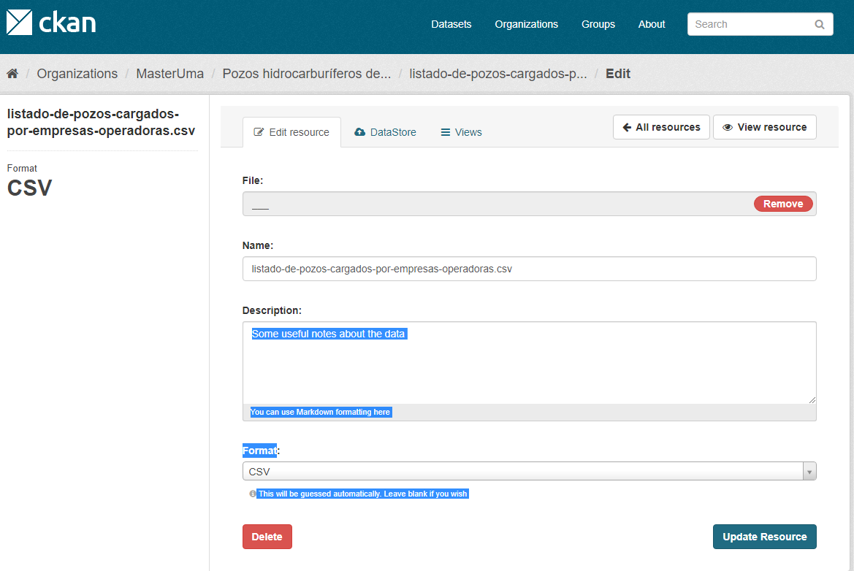

Slide 13
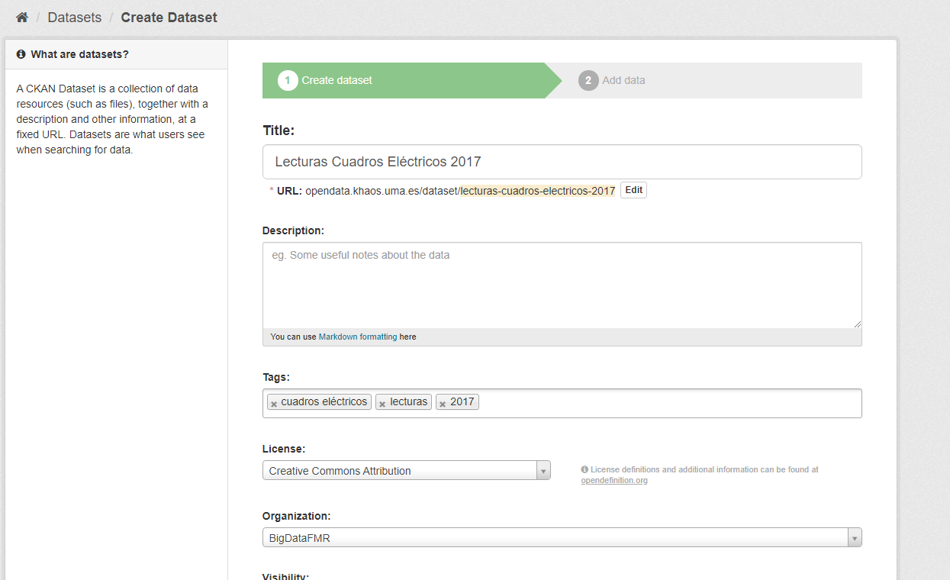
Step 5. Making new Dataset in other organization
External Resource BigDataFMR (owner Fernando Muñoz)

Slide 14
